Slide 1
RPID
By:S.Yadavendra.reddy
R.no:160116737120
By:Billa Sanjay
R.no:160116737321

Slide 2
Abstract

Slide 3
Introduction
The worlds population has been rapidly increasing since the past few decades
Due to this there has been decrease in natural resources such as water and as summer approaches there will be more deficit of water
There have been systems which use previous data and predict in future but as weather continuously changes so in order to take data continuously we are integrating use of IOT device and deep learning models to predict occurrence of rainfall and weather conditions

Slide 4
Introduction
The applications of this software is to take data at continuous interval as 10 mins

Slide 5
Problem Statement
The problem statement being able to predict the future possibility of rainfall and weather condition by taking present data and past data
To build a deep learning model to predict rainfall and weather condition

Slide 6
Software and Hardware Req
Hardware:Arduino device,Breadboard,Resistor
DHT11 Sensor, JumperWires,Laptop
USB Cable
Software:
O.S:Windows 10
Technologies:Python3.7,C++
Dependencies: Arduino IDE,Anaconda,Keras
Tensorflow,Spyder IDE

Slide 7
System Design
Flow Chart of software
Software
Train data
IOT to take data
Deep learning algorithms
Model
Test data
Output

Slide 8
Code/Algorithm

Slide 9
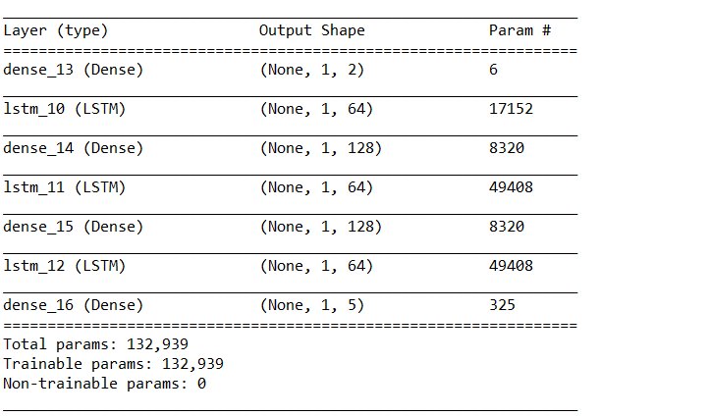
Testing/Model Summary(1)

Slide 10
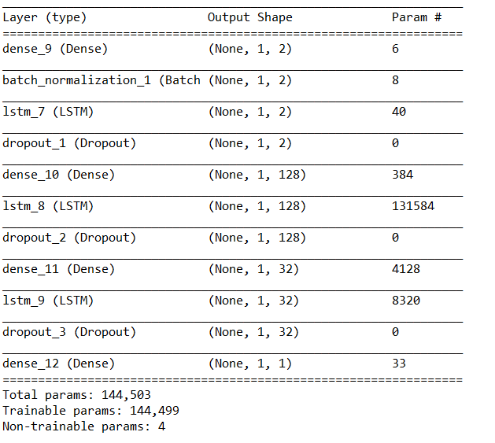
Testing/Model Summary(2)

Slide 11
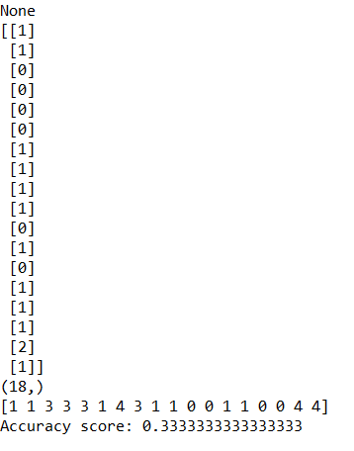
Results

Slide 12
Conclusion and future scope
This software is on small scale and can’t interact wirelessly hence we would like to improve the accuracy of model
The system can be improved to take other data such as pressure,dew point ,Wind direction

Slide 13
Bibliography
https://www.arduino.cc.
https://machinelearningmastery.com
https://www.keras.io
www.anaconda.com

Slide 14
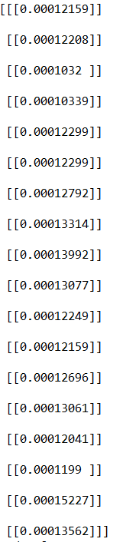
Results

